Slide 1
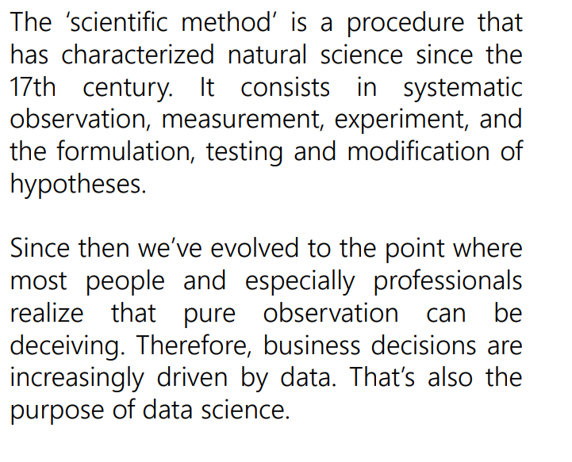

Slide 2
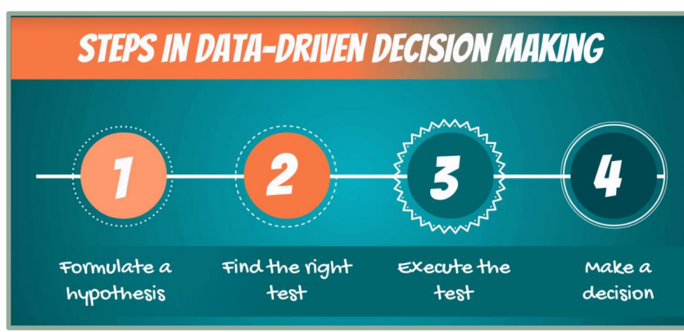

Slide 3
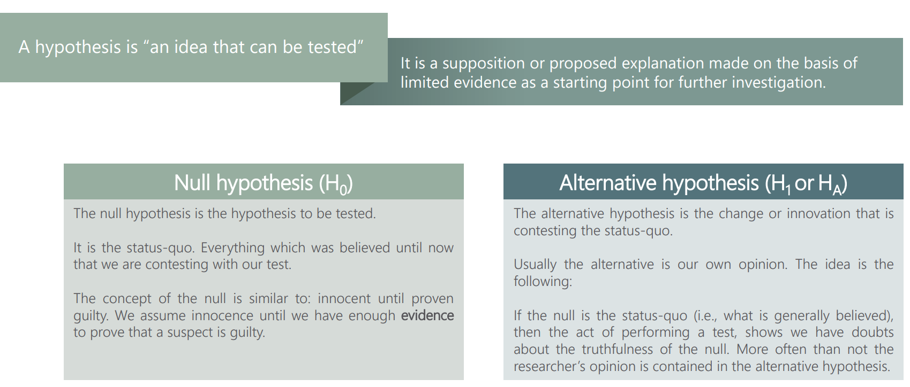

Slide 4
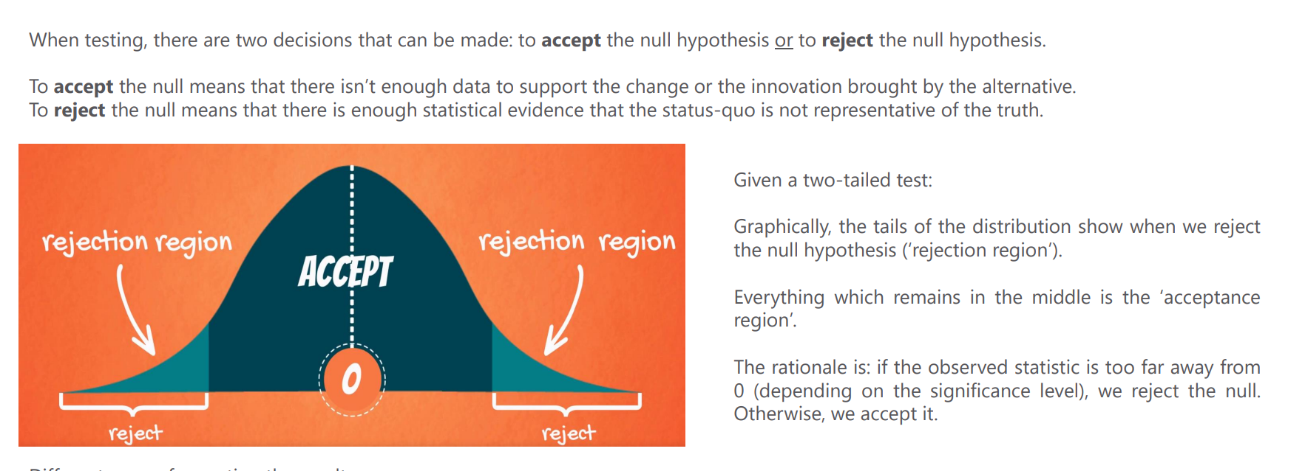

Slide 5
Linear Regression

Slide 6
Linear Regression
Theory of LR
Simple Implementation with python
Scikit-Learn Overview
LR with Scikit-Learn
Polynomial Regression
Regularization
Overview of Project Dataset

Slide 7
History and Motivation of LR
Brief history : Ships-Oceans-Stars..etc
Averaging different results like Housing prices
1805- First publication of Linear Regression
Linear Relationships
Y = X
Ordinary Least Squares
Minimzing the sum of the squares of the difference between the observed dependent variable and those predicted by the Linear function
Cost Functions
Gradient Descent
Vectorisation

Slide 8
OLS
Y = mx + b
M is slope
b is intercept
Multiple features
Area : 200,190,230,180,210
Bedroom : 3,2,3,1,2
Bathroom : 2,1,3,1,2
Price :
Best estinatio (y-hat)

Slide 9
Slope
Positive slope
Negative slope
Zero slope
M is the slope of the line
b is where the line crosses the y axis when x = 0

Slide 10
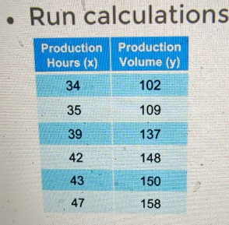
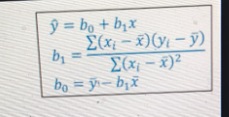

Slide 11
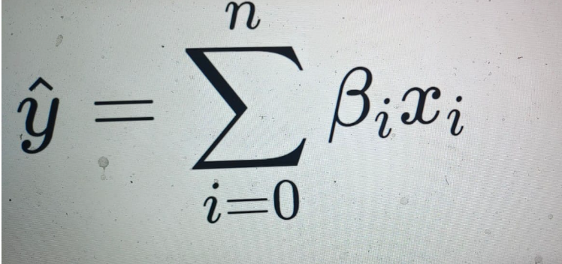

Slide 12
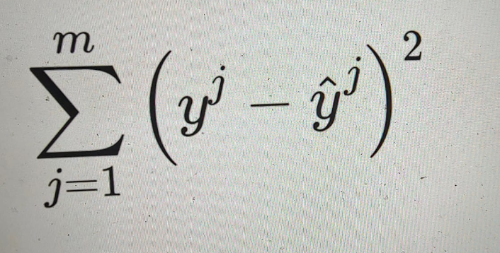

Slide 13
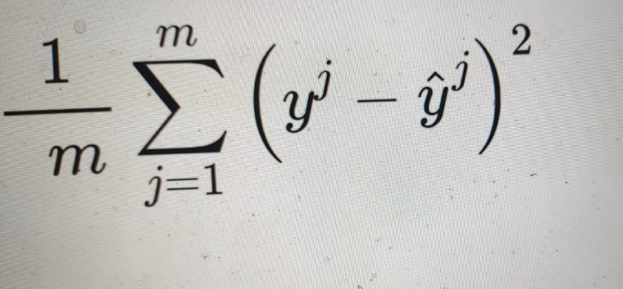

Slide 14
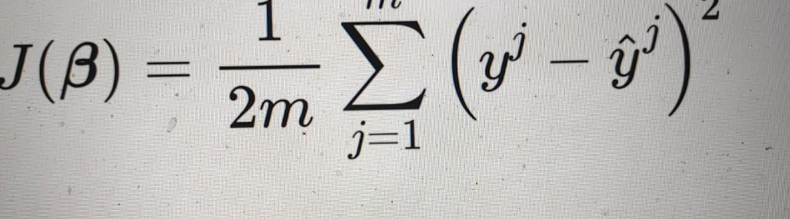

Slide 15
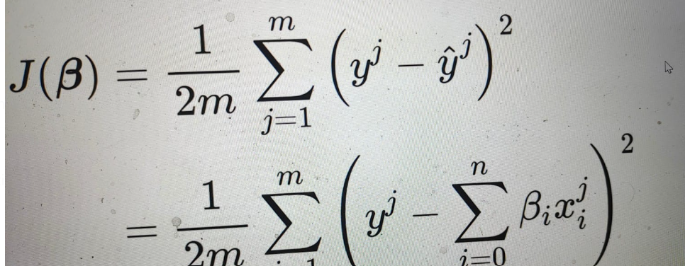

Slide 16
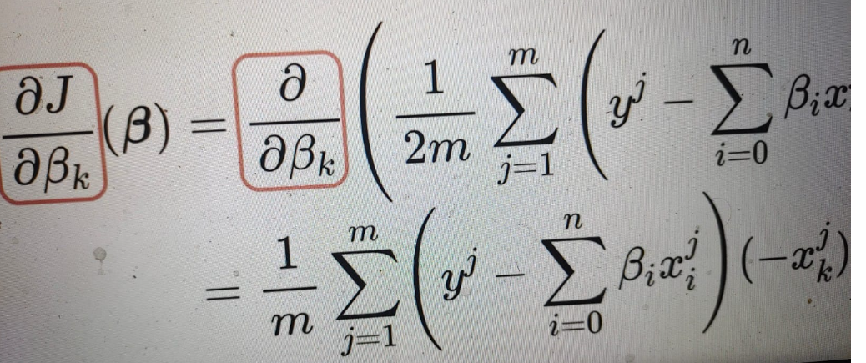

Slide 17
